Slide 1


Sprint Transforming into a Leader
Chris Eumont
Aniket Patel
Clayton Petty
Dakota Plesa
Notes:
Aniket

Slide 2
Agenda
Our Understanding of Your Needs
Strategy
Strategic Criteria
Short Term Focus on Cash
Subscriber Growth
Future Considerations
Implementation Plan
Notes:
Aniket

Slide 3
Our Understanding of Your Needs
Needs
Solutions
Current Situation:
Currently 4th in a highly competitive and rapidly changing market
Highly leveraged with looming debt obligations
High subscriber churn
Goals:
Rebalance company as a healthy industry player
Diversify product offerings
Increase network availability
Short Term Focus on Cash
Subscriber Growth
Notes:
Chris

Slide 4
Strategy Pt. 1: Short Term Focus on Cash
Notes:
Chris

Slide 5
Creating Financial Flexibility via Debt Restructuring
1
Current Outstanding Debt at Avg. 8.56% Coupon Rate
Large Amounts of Debt taken on in high interest rate environment
$22,280.18 M
2
Current Annual Debt Interest
Higher interest rates have led to debt loads unreflective of current situation
$1,906.69 M
3
Annual Debt Interest after restructuring at 6% Interest Rate
Strengthened company position has led to a lower cost of debt
Plan to offer incentives to bondholders such as stock options to entice buybacks
$1,336.81 M
$569.88 M
Total Cost Savings
Notes:
Clayton

Slide 6
Refocus on Core Business Through Wireline Sale
Revs
Costs
Profit
Wireless
$24.6 B
$16.5 B
$8.0 B
Wireline
$2.3 B
$2.2 B
$0.1 B
Total
$26.9 B
$18.7 B
$8.1 B
Sale of Wireline Business for Total Gain of $2.7 Billion

Slide 7
Strategy Pt. 2: Subscriber Growth
Notes:
Clayton

Slide 8
Subscriber Growth via Content Consumption
1.3 Million New Subscribers
14.3% Decrease in Churn
$61.5 Million Opportunity
Notes:
Dakota

Slide 9
A Future to Consider: Acquire T-Mobile
Merger Approval
Proposed in 2014 but was denied by FCC
Sentiment that new FCC team will be more open to mergers
Softbank CEO Masa Sun has expressed interest in a deal since Sprint was acquired
Stocks of both companies rose after election day
Benefits
Larger customer base and combine for wider reaching network
More power to influence the market and compete on a more level playing field with AT&T and Verizon
More pricing power in highly price based industry
Increased Revenue: $24.9 B
31.7 M Subscribers Added
Notes:
Dakota

Slide 10
Implementation Plan
2017
2018
2019
2020
2021
2022
Debt Restructuring
Implement and Run Content Consumption Data Policies
Sale of Wireline
Align Pricing with Top Competitors
Acquire T-Mobile and integrate
Monitor Government Actions and Leniency
Cash
Subscriber Growth
T-Mobile
Notes:
Clayton

Slide 11
Conclusion
Strategy | Net Gains | Other
Debt Restructuring | $570 M | Stronger Financial Health
Wireline Sale | $2.7 B | Removing Excess
Youtube Deal | $61.5 M | 1.3 mm new Subscribers and 14% reduced churn
Acquire T-Mobile | $24.9 B | 31.7 M subscribers added
Total | $28.23 B | Stronger Competitor with AT&T and Verizon
Notes:
Aniket

Slide 12
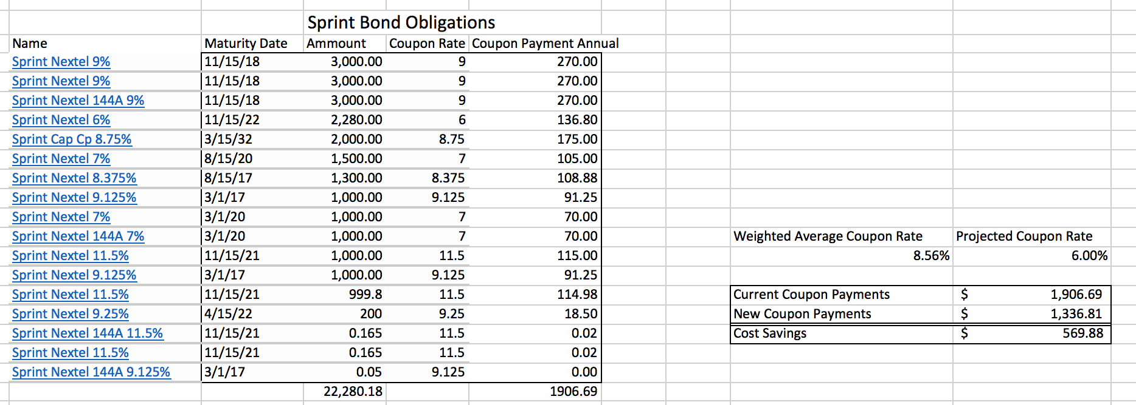
Appendix: Debt Restructuring

Slide 13
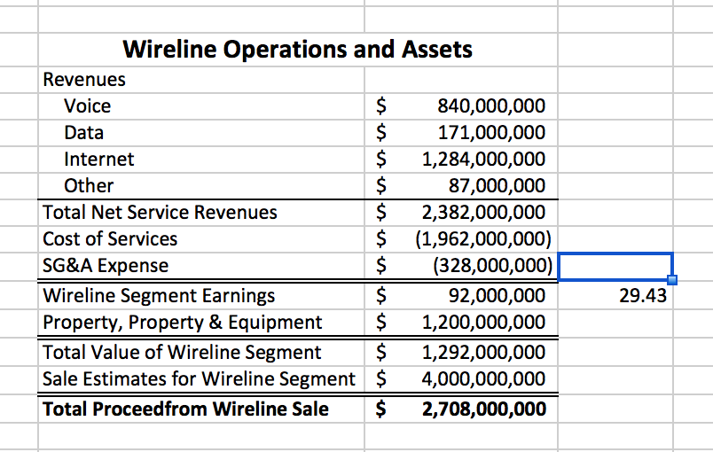
Appendix: Wireline Sale

Slide 14
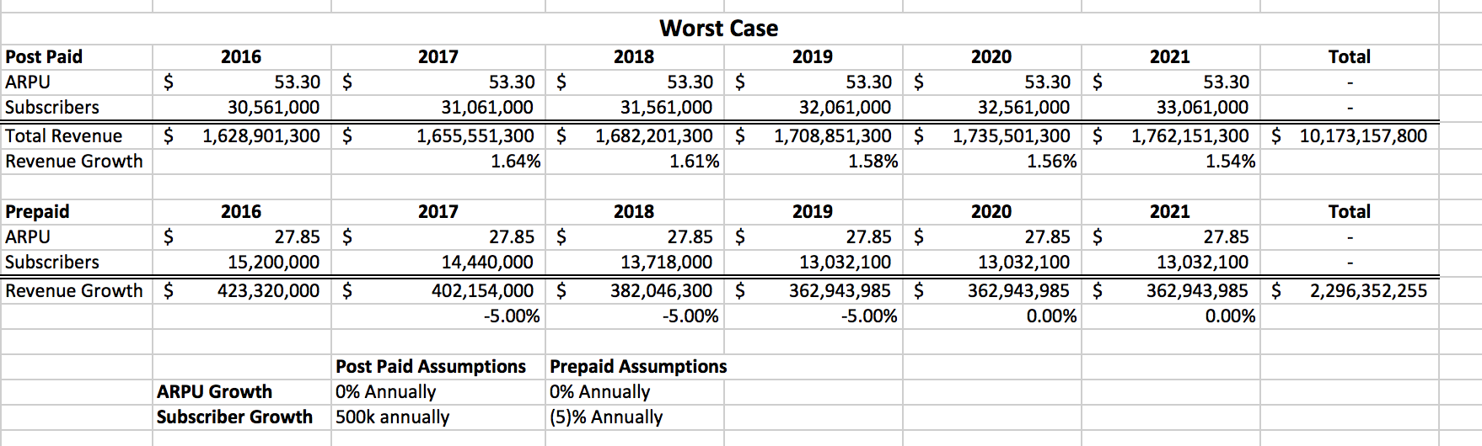
Appendix: Growth Worst Case

Slide 15
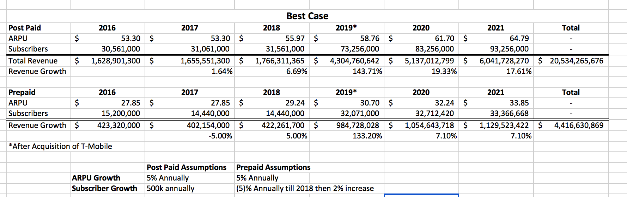
Appendix: Growth Best Case

Slide 16
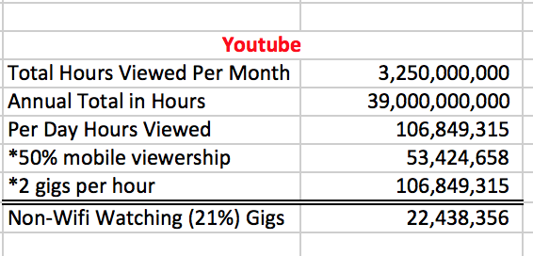
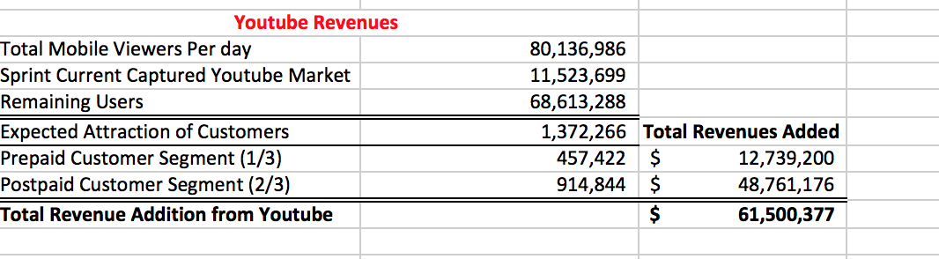
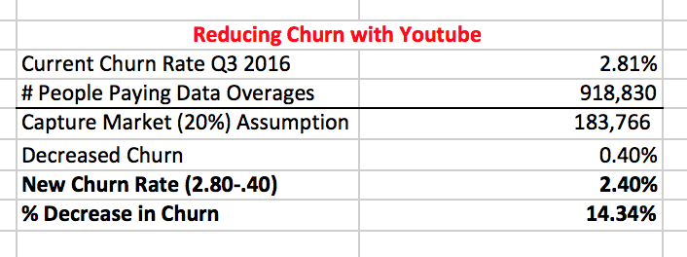
Appendix: YouTube Deal

Slide 17
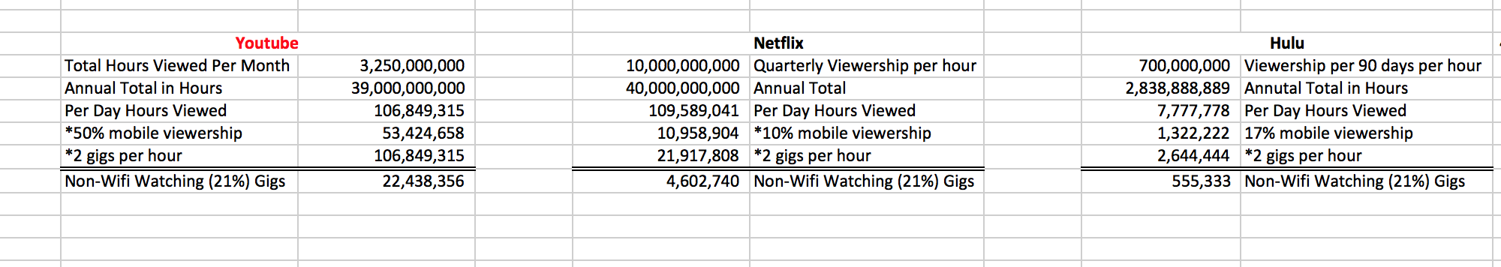
Appendix: Why YouTube?

